Slide 1
‘Retro’ Writing
Using Informal Assessments in Early Literacy

Slide 2
Today’s Presentation
Goal
  Practice using Adobe Connects
  Useful information for future Professional Development sessions or Faculty Meetings
  Review of useful techniques
Plan
  Briefly discuss benefits of informal assessments
  View examples
  Address questions regarding informal assessments
  Practice Adobe Connect

Slide 3
Informal Assessments Today
What makes an informal assessment effective or worth the effort?
How are informal assessments useful for literacy development?
How do informal assessments complement formal assessments?

Slide 4
Hidden Gems in Student Writing
In what ways is student writing useful?
What can it demonstrate?
Student writing is a “gold mine” of information about the student’s orthographic knowledge
Progression over length of time
  Thinking skills
  Motor Skills
  Literacy Skills
Provides a forum for personal development

Slide 5
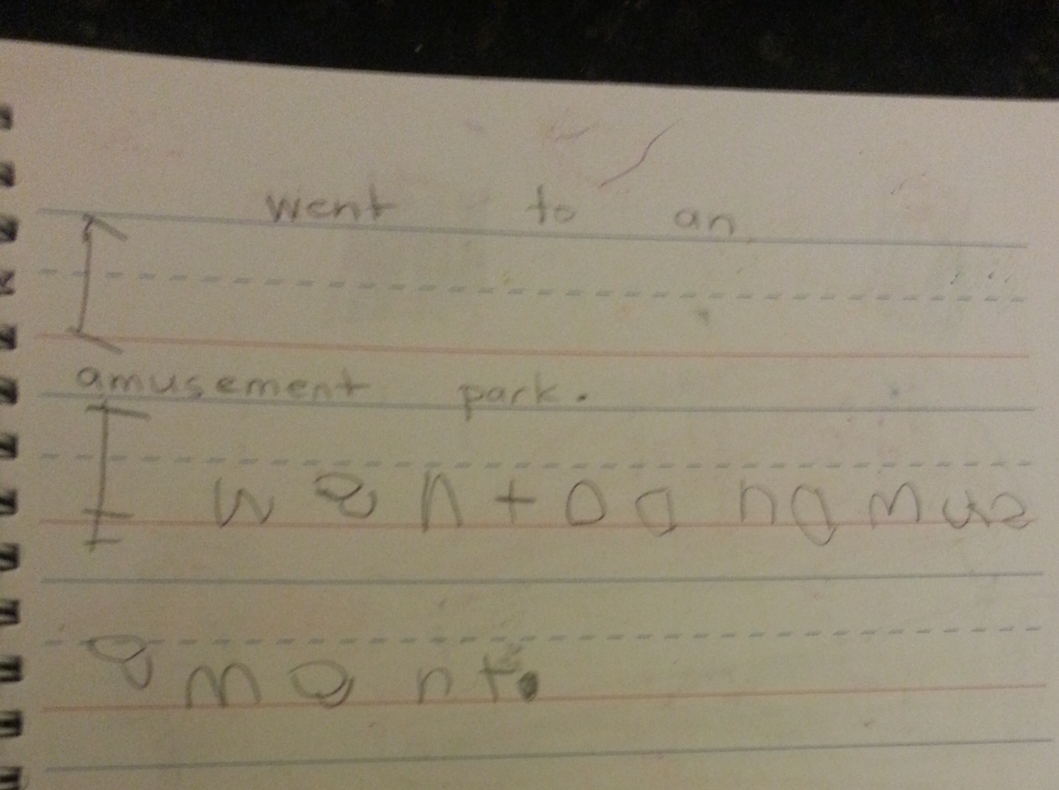
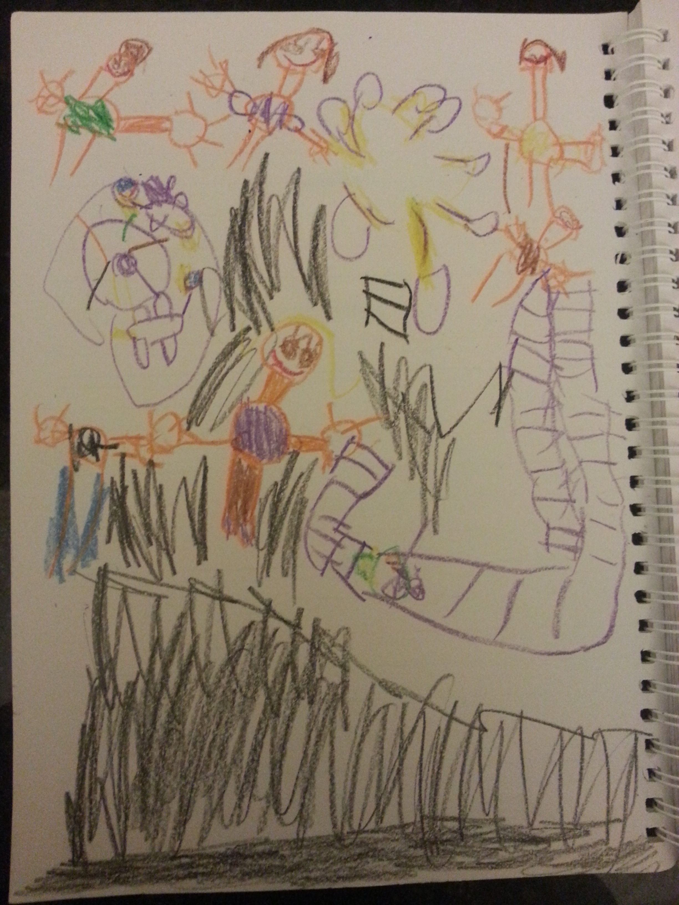
August 2013

Slide 6
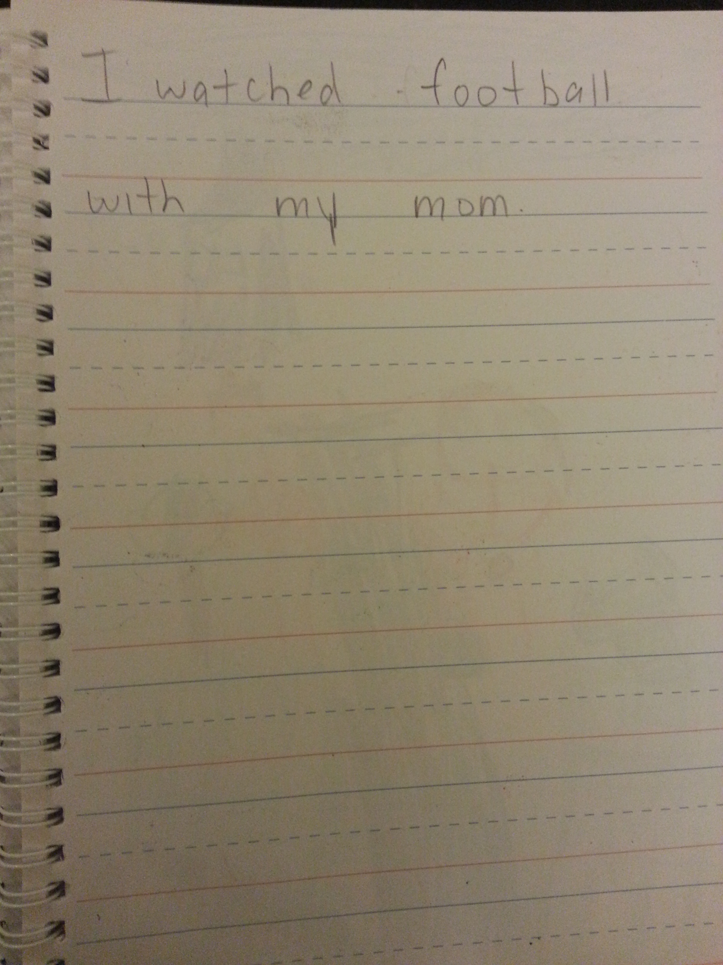
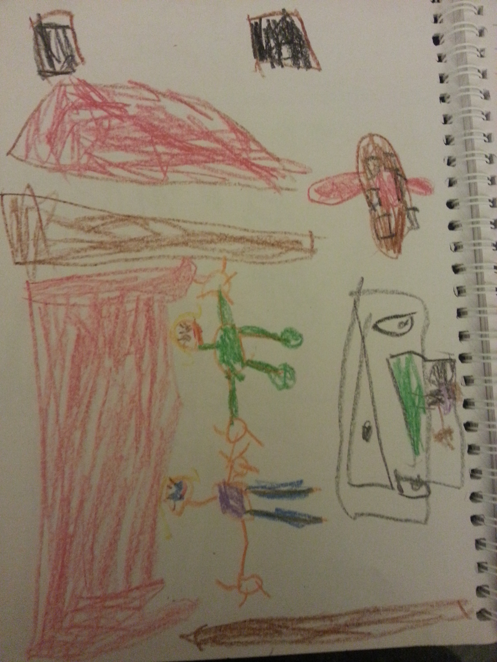
September 2013

Slide 7
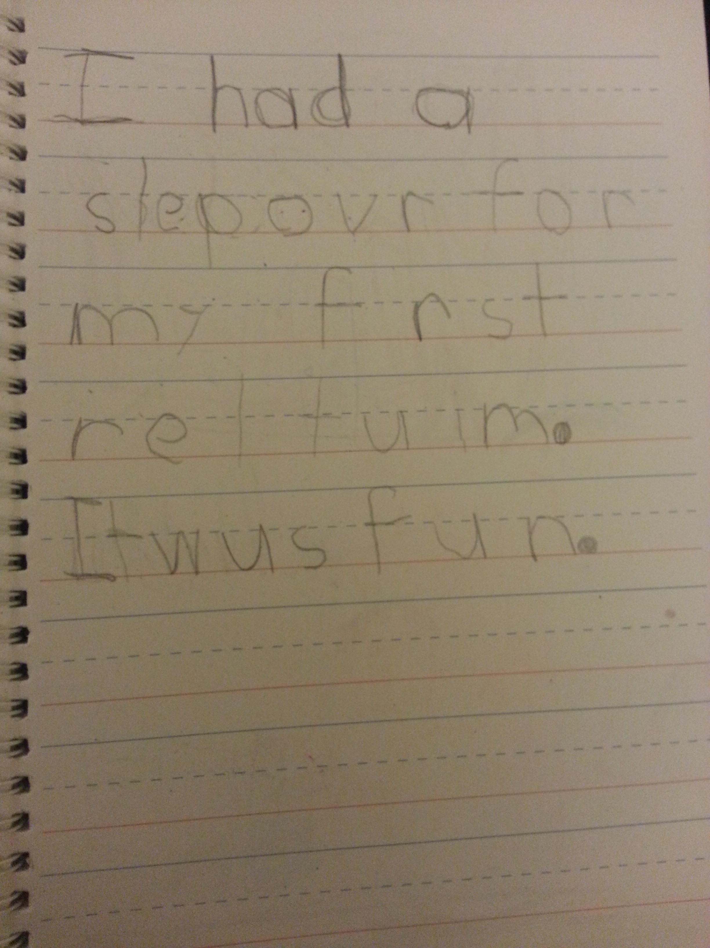
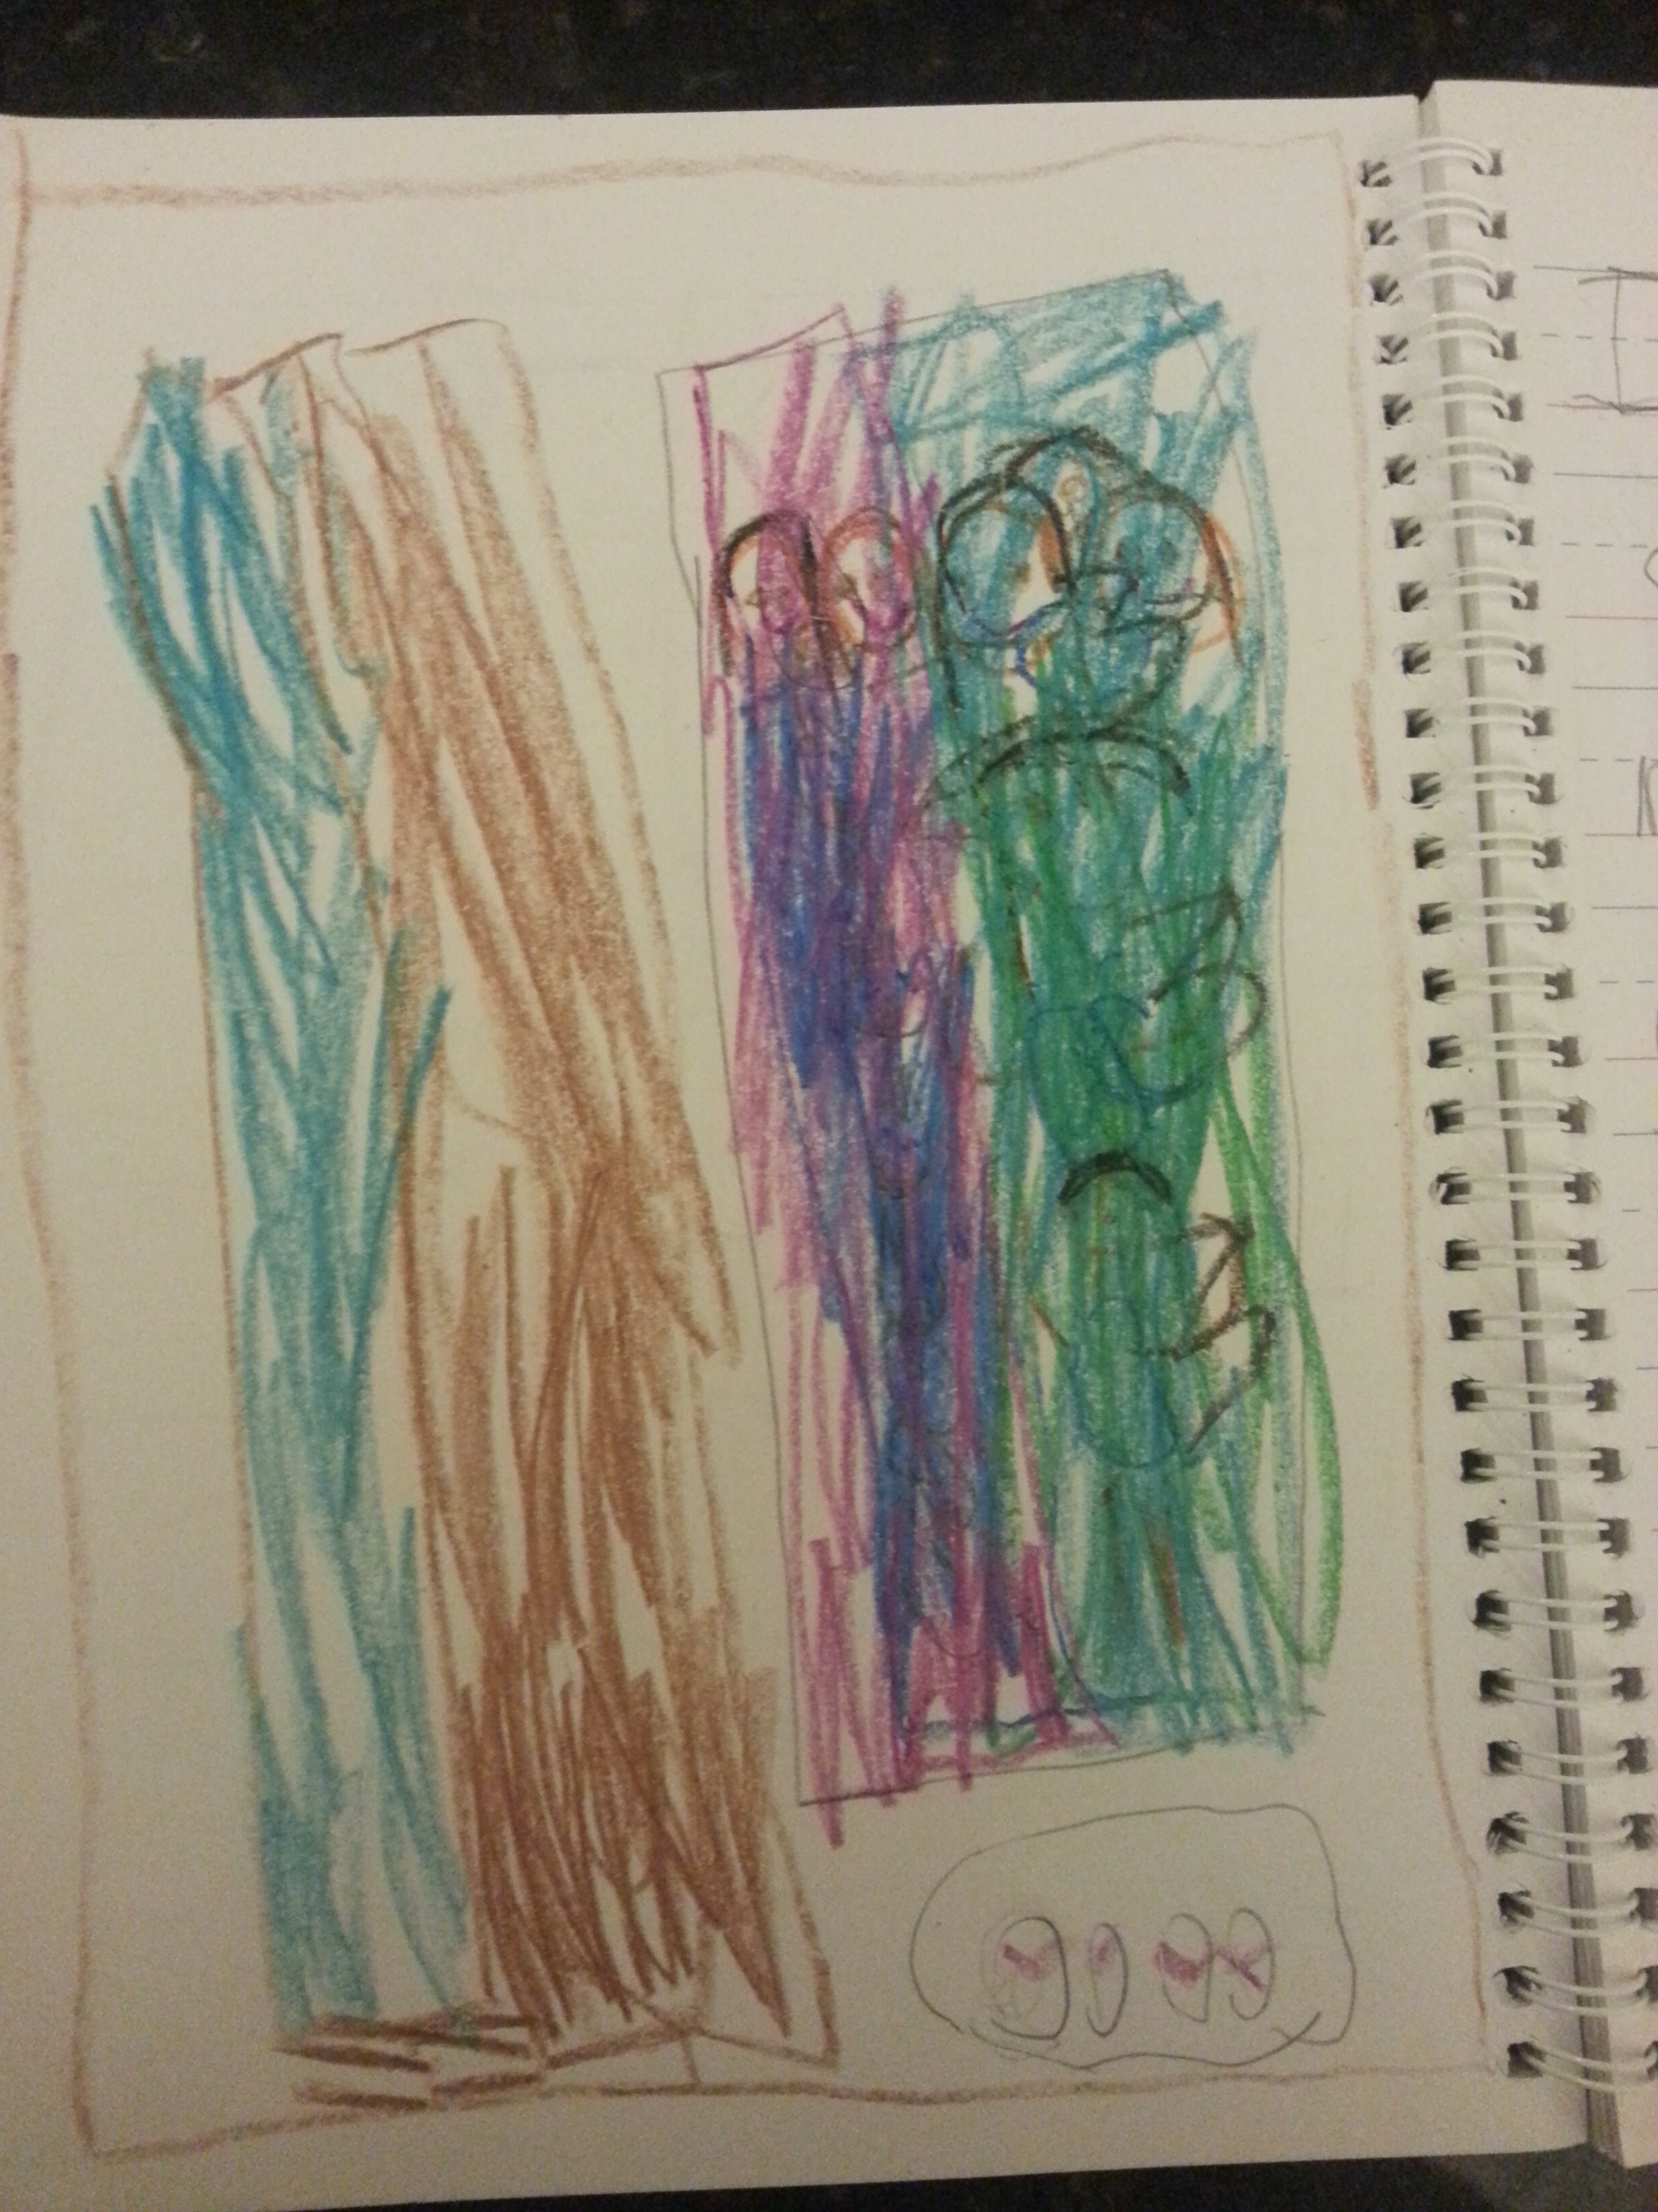
January 2014

Slide 8
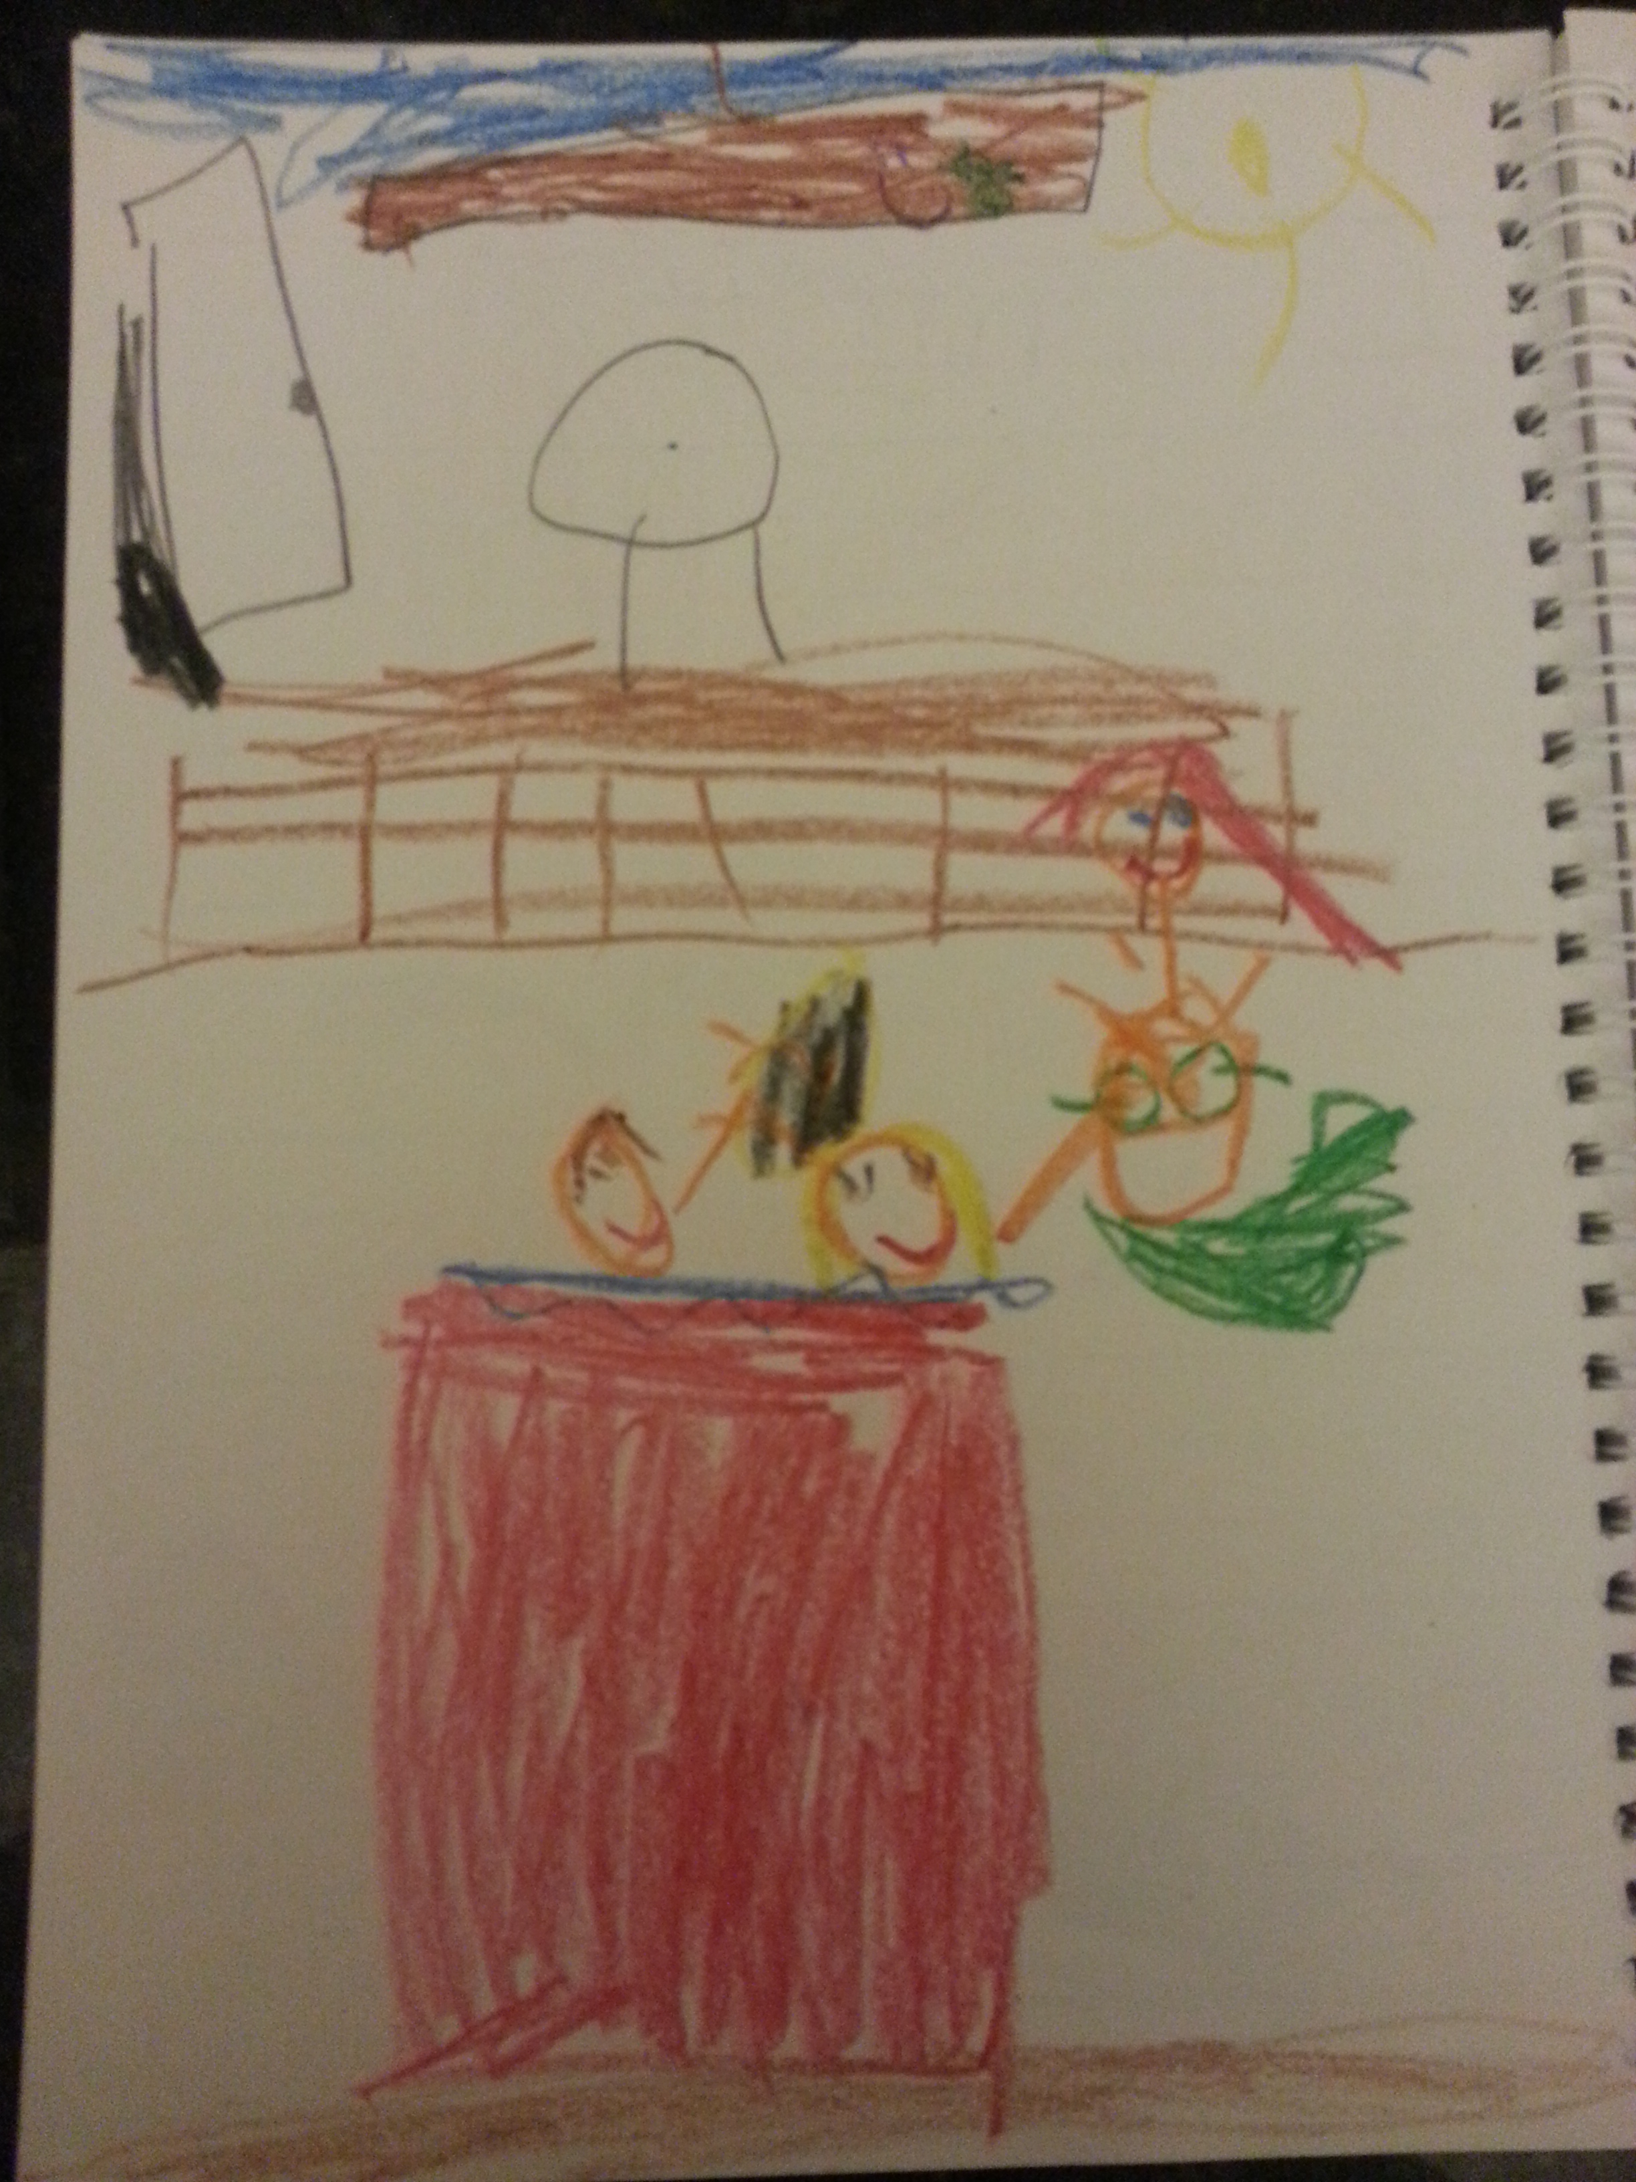
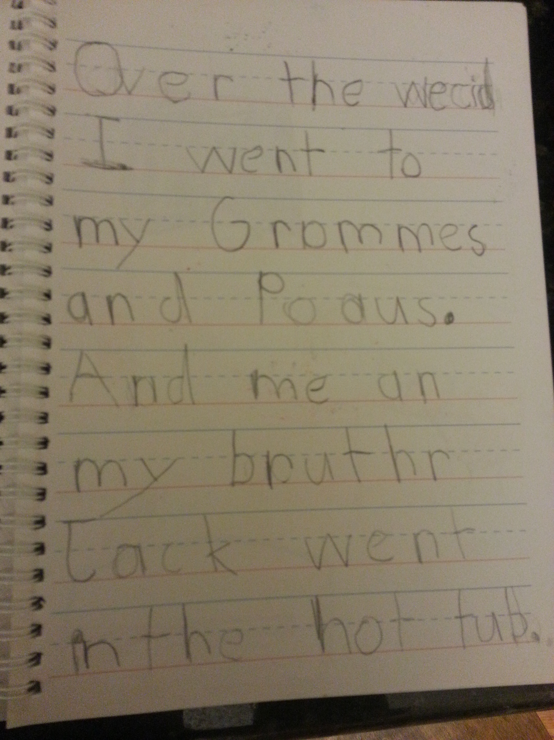
April 2014

Slide 9
Benefits of Informal Assessments
Individual academic progression
Application of skills and strategies
Provides feedback for adjusting future lessons
Potentially comparative to standardized tests’ writing prompts
Connections between home and school

Slide 10
Some Literacy Research
Student reading can also be illustrative about the student’s orthographic knowledge
Reading skills are slightly ahead of students’ spelling accuracy
Spelling is a conservative measure of word knowledge
Some errors are to be expected at different stages
May use the pictures instead of reading the words on the page (semiphonetic stage)
Oral reading substitutions may indicate a transitional reader who understands many aspects of the word
Spelling and reading errors are limited in their predictive abilities, so further assessment is needed

Slide 11
Questions?

